Slide 1
How To Work From Home Without Living At Work
An Exploration on the Checks and Balances

Slide 2
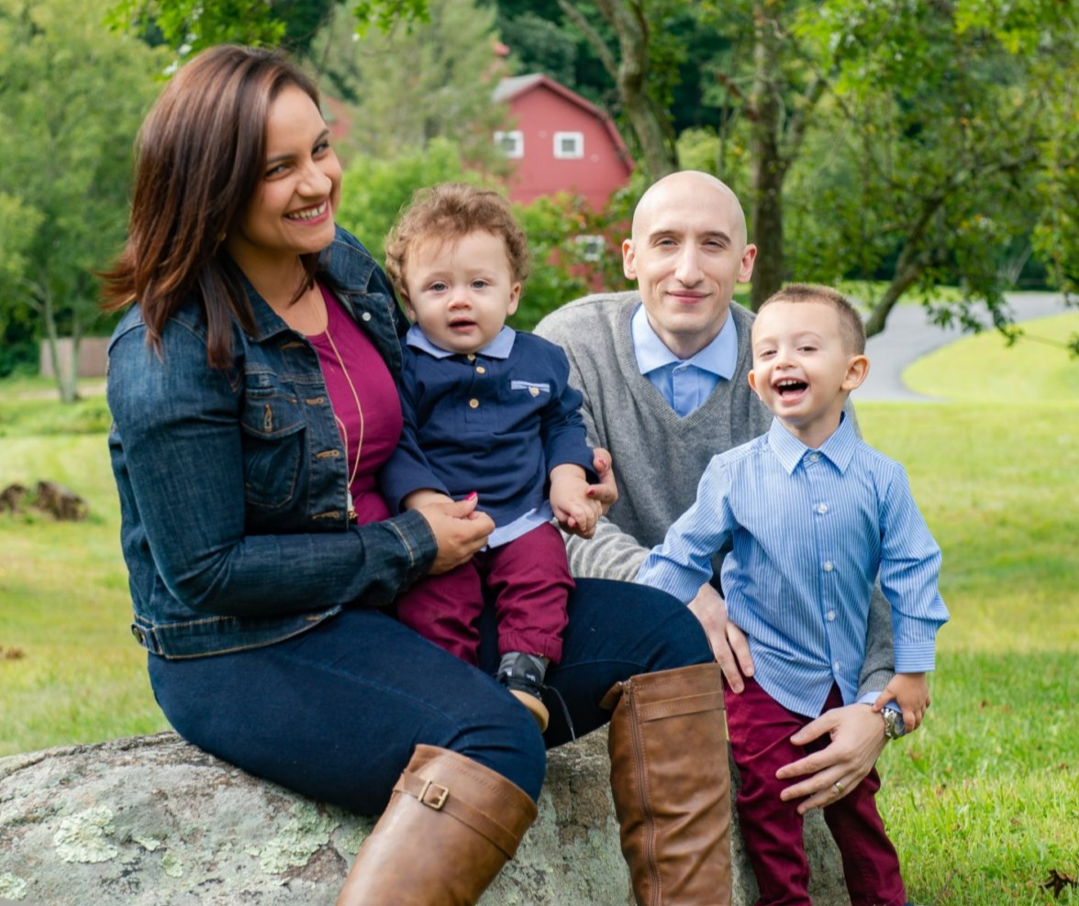
My name is Isaac
I work at Microsoft
I work from home
Norwalk, CT
Wife (Ariana)
Nearly 4 year old (Isaac)
Nearly 2 year old (Avery)

Slide 3
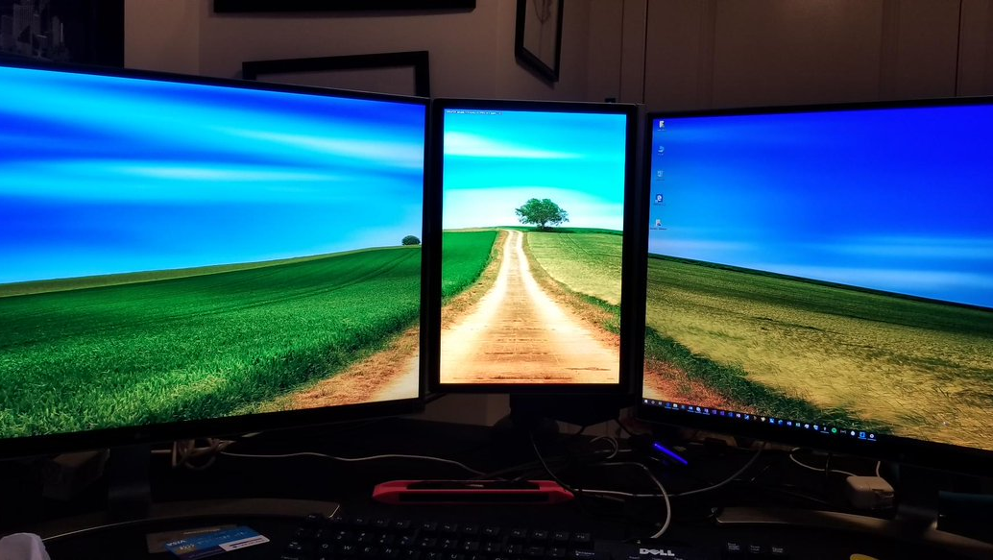
My work from home story

Slide 4

Working from Home Positives?

Slide 5
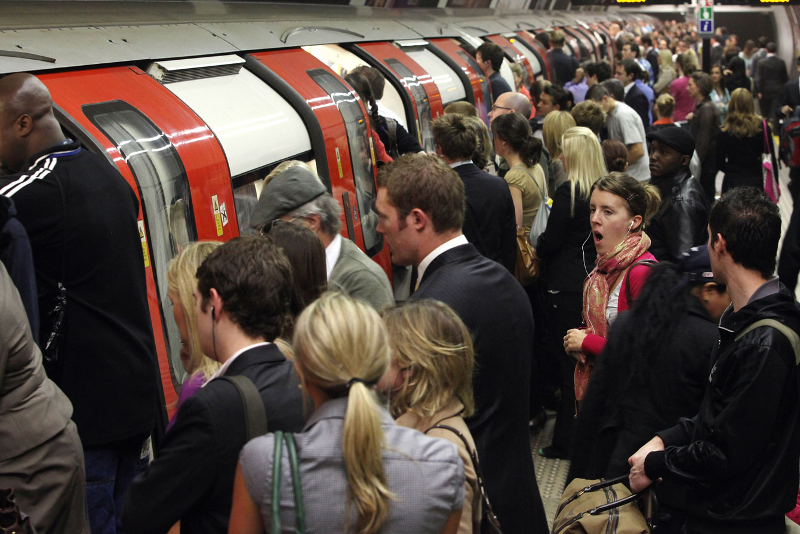

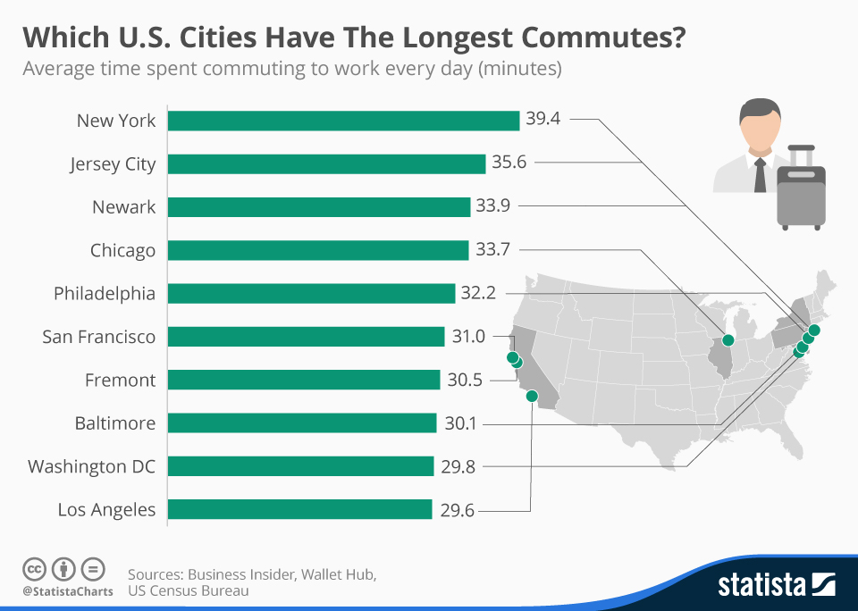
No Commute
Notes:
Traffic
Train commuting

Slide 6
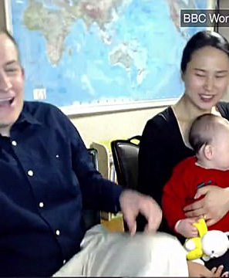



Work/Life Balance
Notes:
More family time
Better time management
Less useless meetings
You can work anywhere

Slide 7
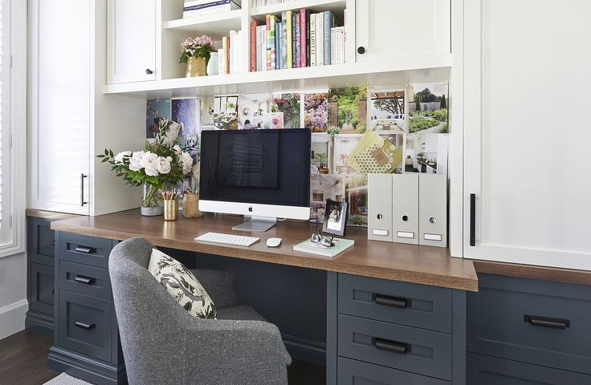

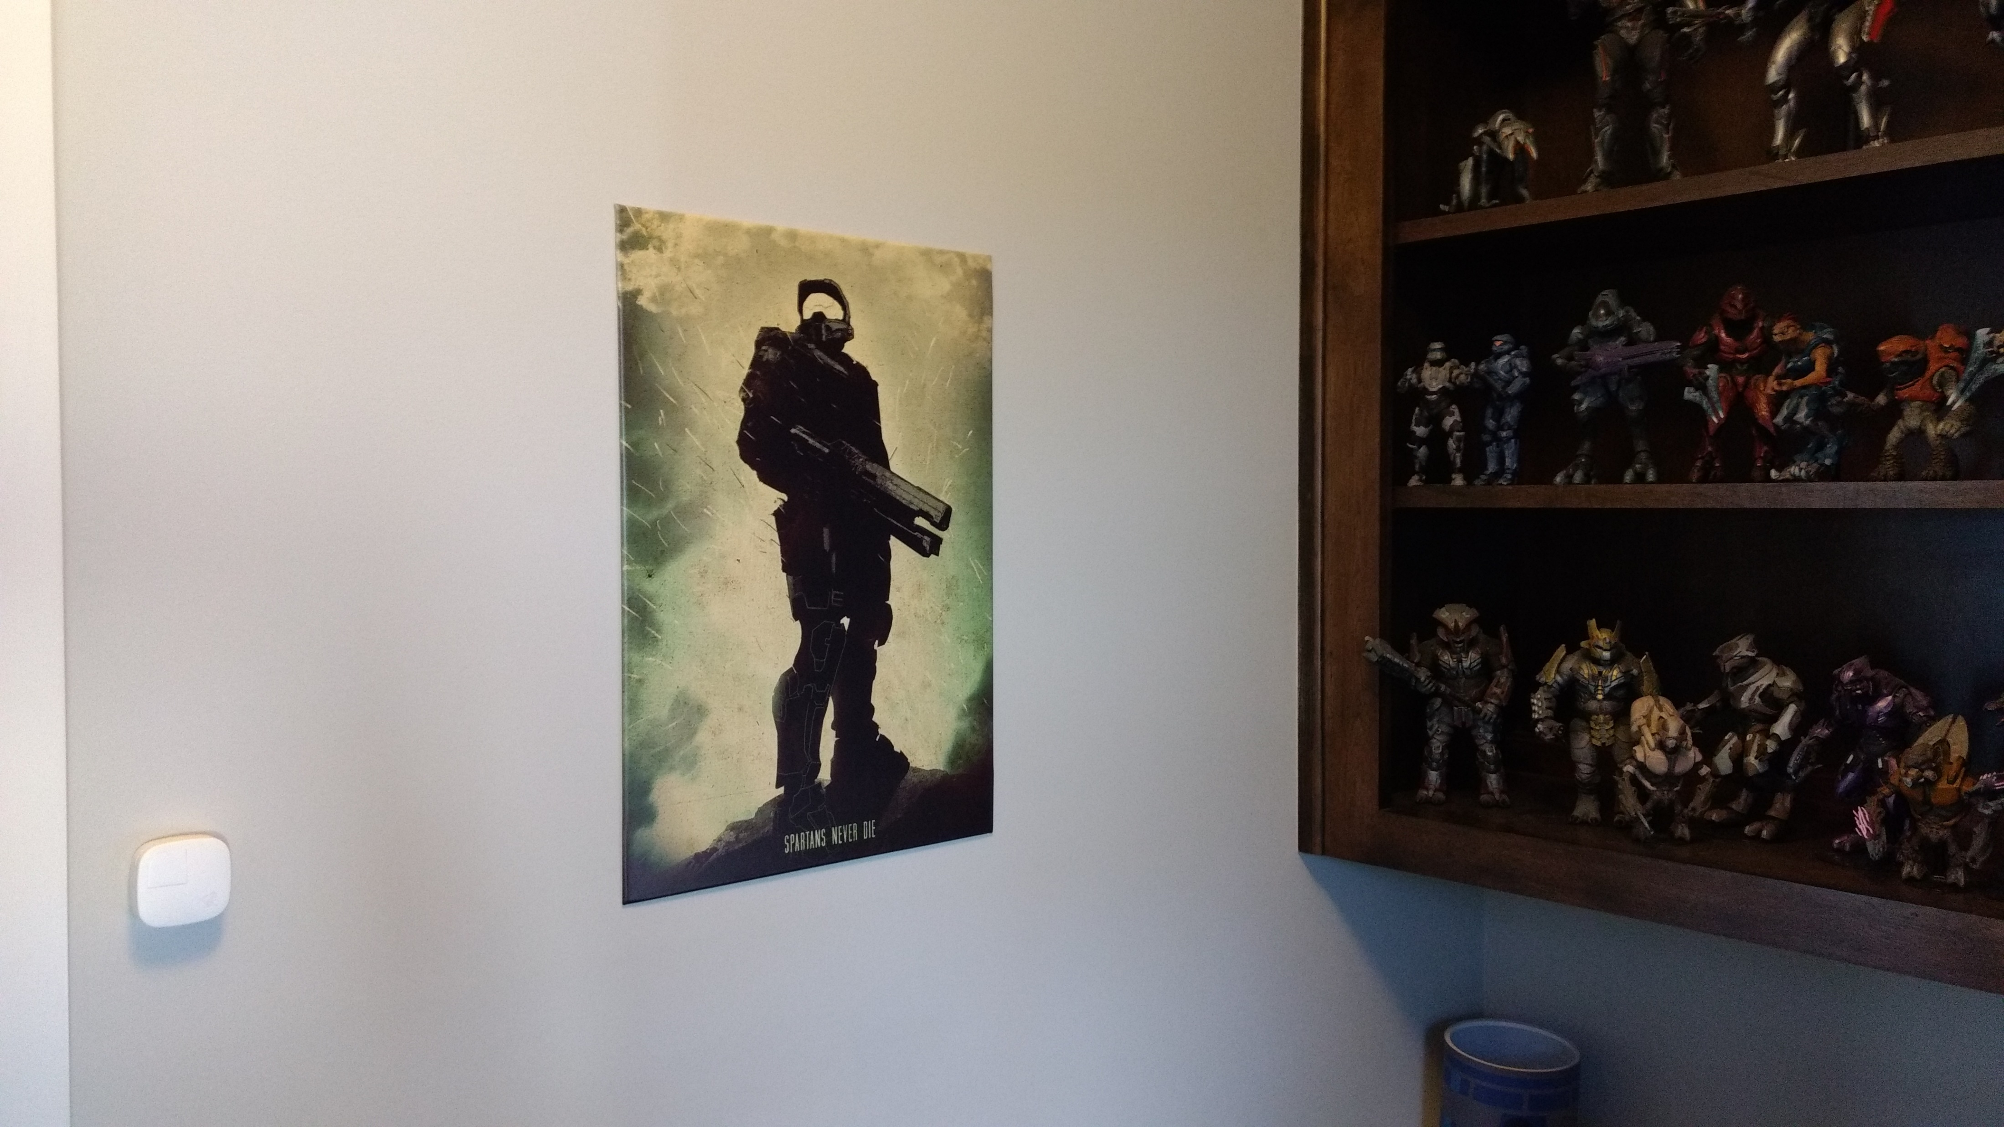
Build Your Own Space

Slide 8

Common Pitfalls

Slide 9
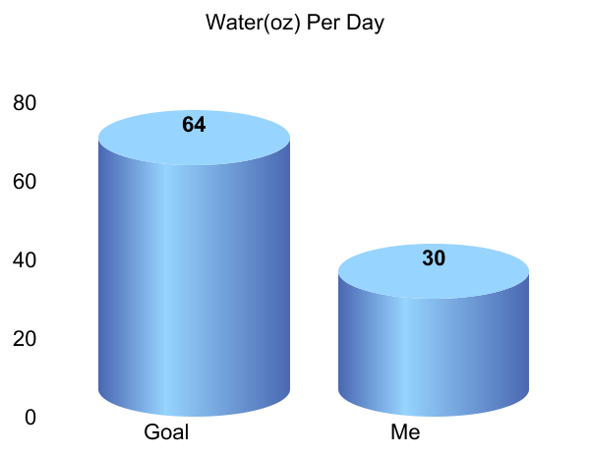

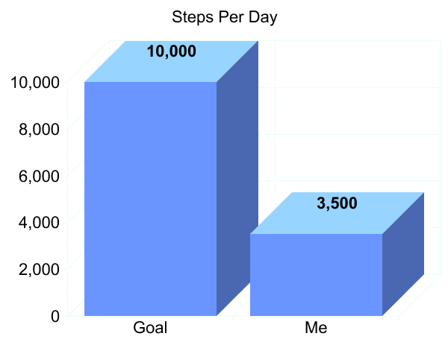
Health

Slide 10
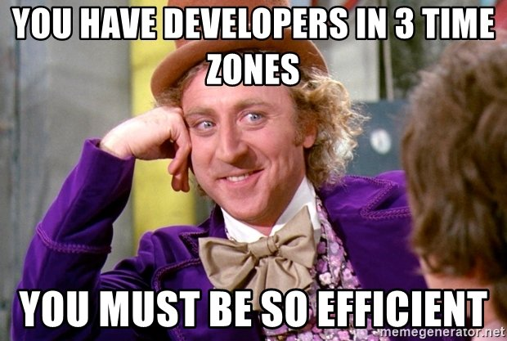
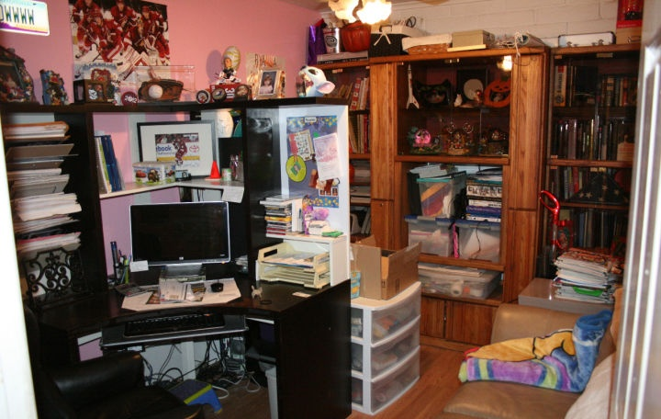

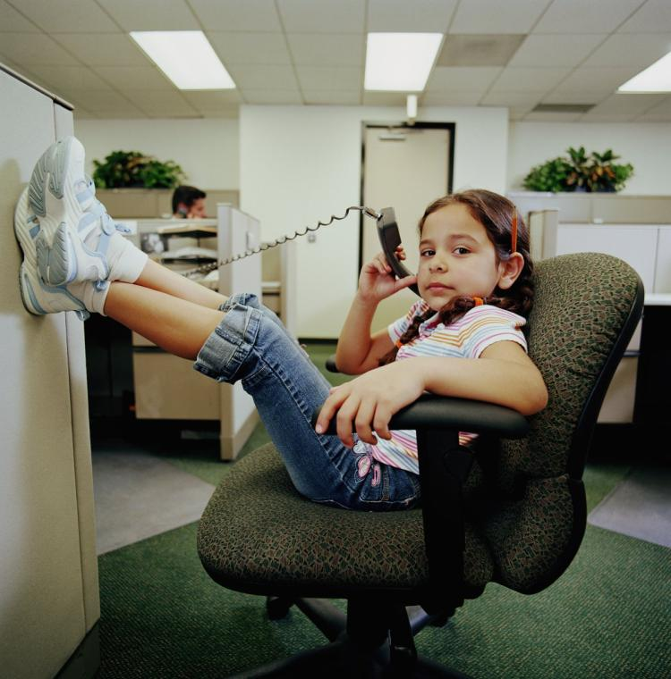
Work/Life Balance
Daddy is Home, I Must Get His Attention
Notes:
Managing time expectations
Distrations in office/work location
Family Distractions
Emails at 10 PM

Slide 11



Social Impact
Notes:
Sucked into Social Media
Isolation
Less Productivity

Slide 12

Mental Health

Slide 13

How Can we Make it Better?

Slide 14
Be Accountable
Notes:
Get Dressed!
Take Breaks, don’t get sucked in, it ends poorly
Act like you are at an office
Keep your calendar up to date
Stick to a schedule

Slide 15
Be Aware
Notes:
Understand people don’t know what you are doing
Be able to step away to come back fresh
Manage your distractions
Don’t try to do it all

Slide 16
Be Present
Notes:
Setup calls to touch base with colleagues
Own your day/week
Set family expectations

Slide 17

2017 Stanford Work From Home Study
2 Year Study
Ctrip (Chinese Company) of 16,000 Employees
500 employees took part in study
Attrition dropped 50%
$2,000 per employee drop in office space needs
13% Improvement in Performance
Notes:
Sucked into Social Media
Isolation
Less Productivity

Slide 18
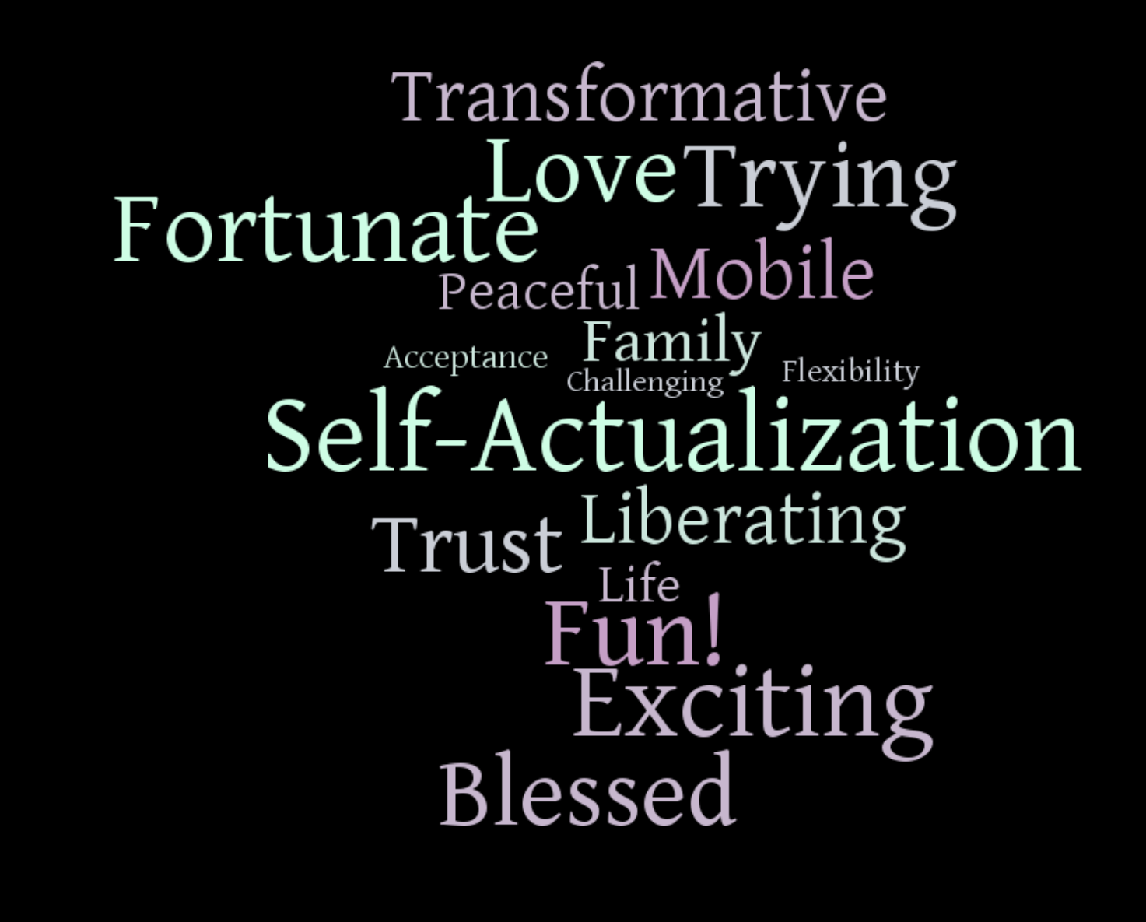
Notes:
Liberating
Flexibility
Blessed
Transformative
Self-Actualization
Fortunate
Fun!
Exciting
Challenging
Trying
Family
Acceptance
Mobile
Trust
Peaceful
Life
Love

Slide 19








Thank you To My Friends

Slide 20

Questions?

